Slide 1
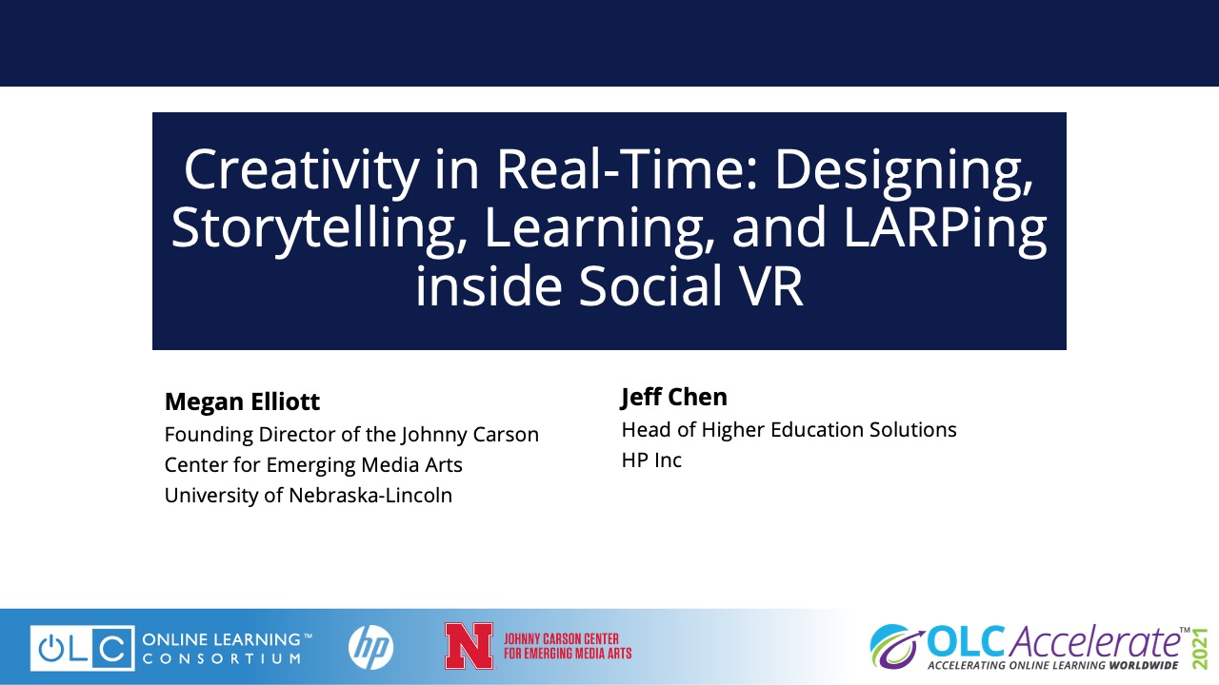

Slide 2

CARSONCENTER.UNL.EDU
SPRING 2019
Professor Ash Smith
Professor Jesse Fleming
Creative Technologist In Residence – Ben Kreimer
Notes:
On the one had there’s Emerging Media = Technology
On the other hand, there’s Media Arts = Creativity

Slide 3
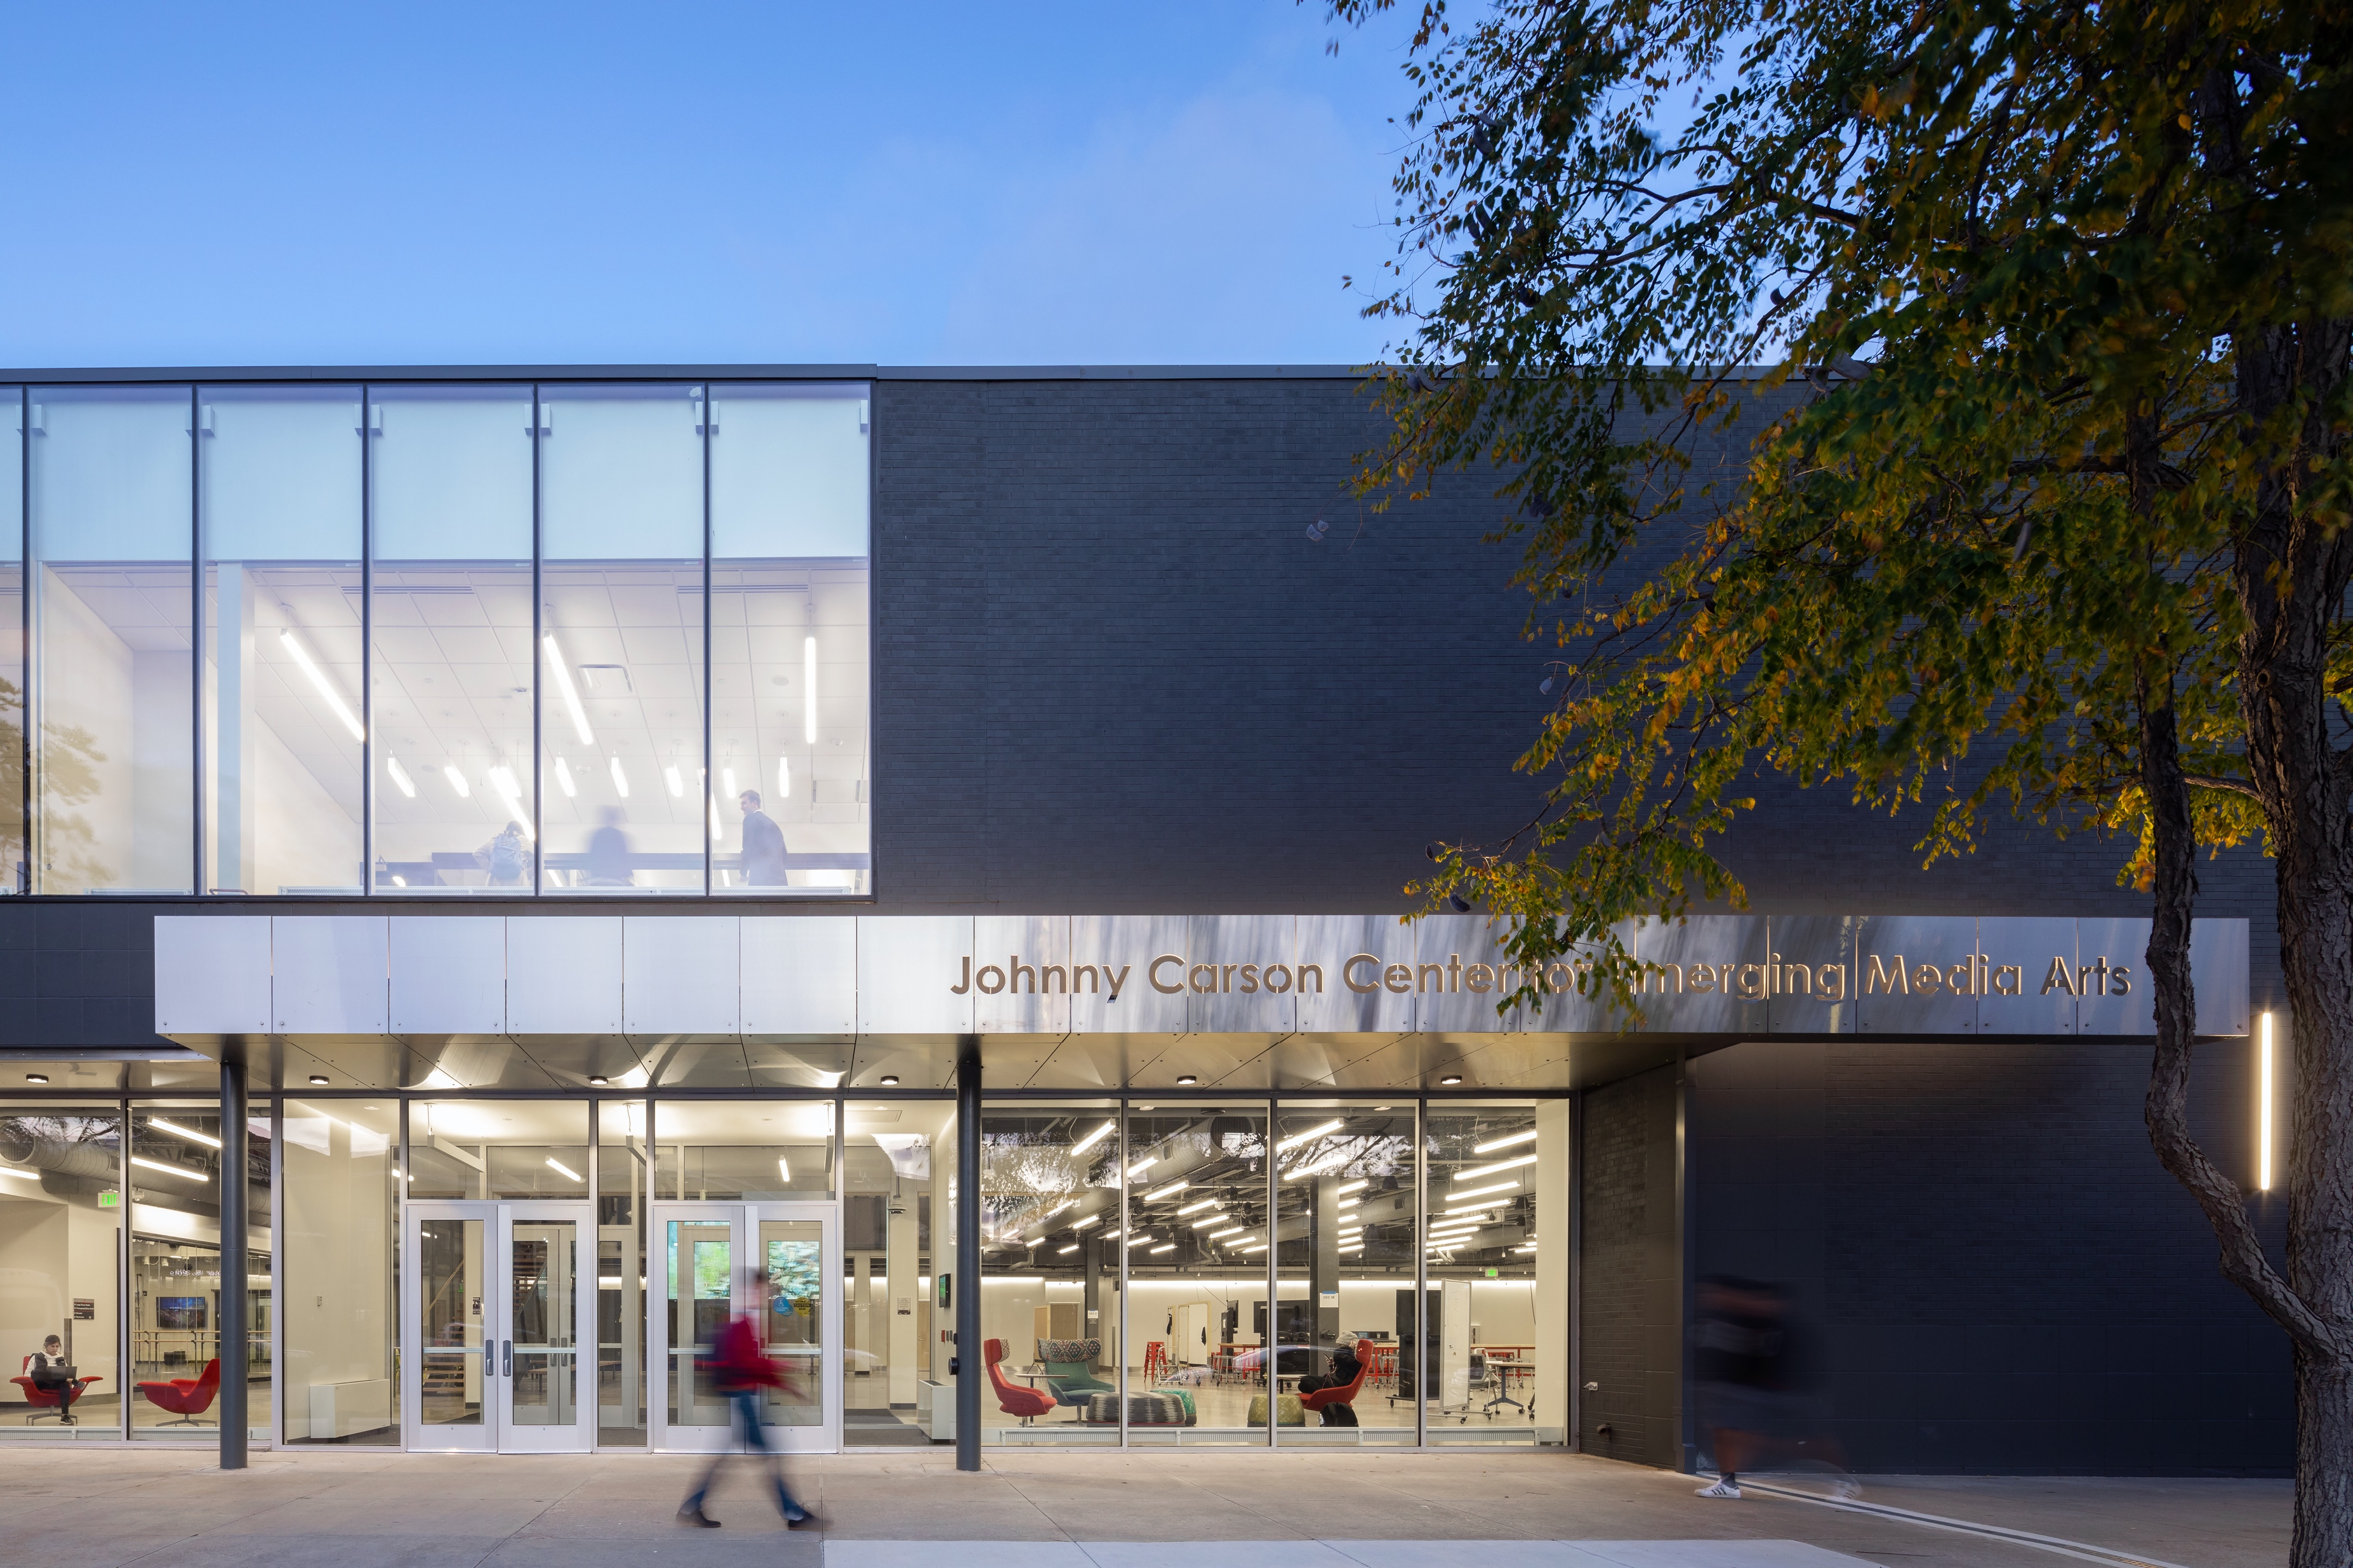
Notes:
Now it’s this

Slide 4
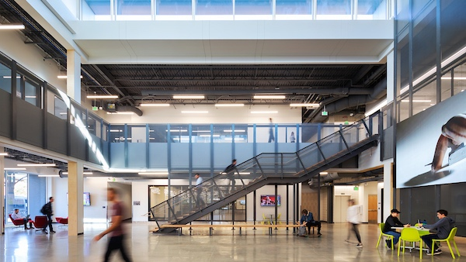

Slide 5
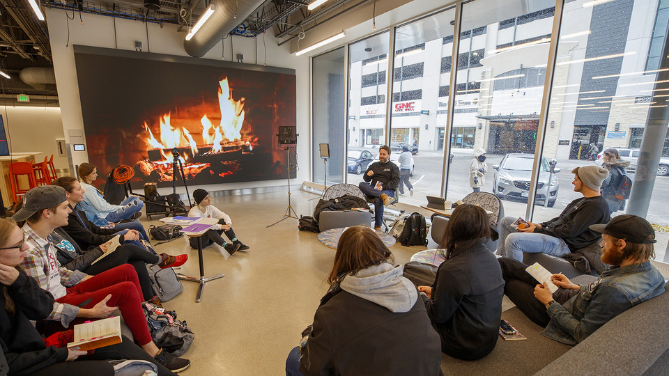

Slide 6


Slide 7
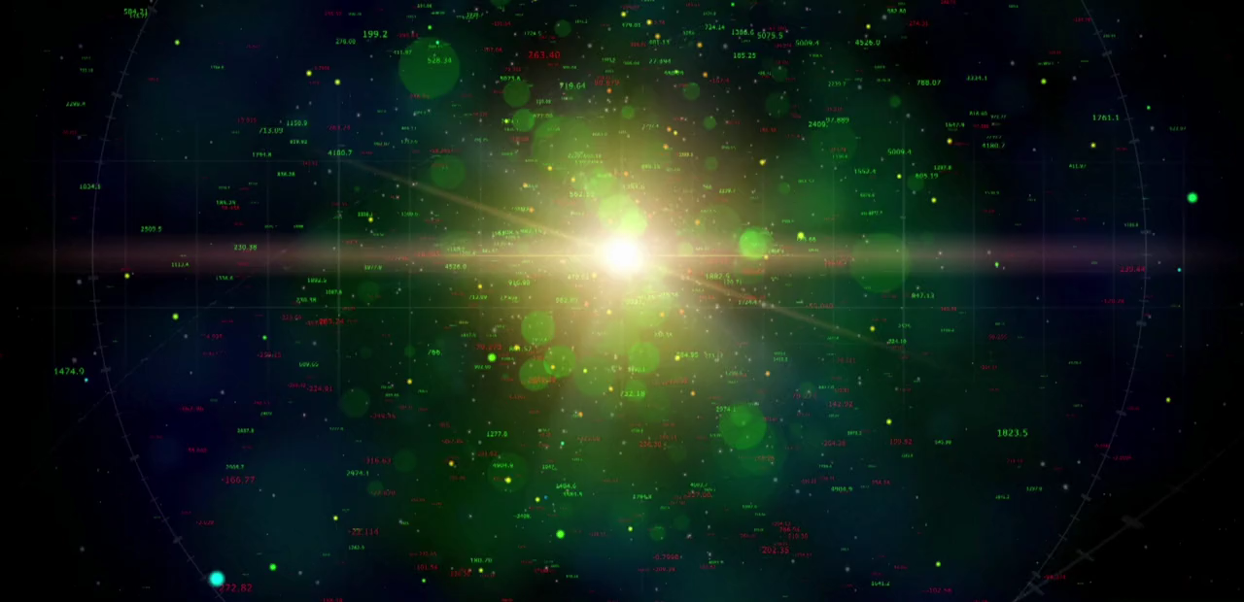
CARSONCENTER.UNL.EDU
a space to meet collectively
to review work
to create work
to share and celebrate work
EMA Open Studios
Notes:
On the one had there’s Emerging Media = Technology
On the other hand, there’s Media Arts = Creativity

Slide 8

Mozilla Hubs
A browser-based 3D virtual world for synchronous social gatherings and asynchronous experiences.
Free
Open-Source
Accessible web-based VR (computers, mobile, HMD)
3D files, Audio, Images, Video, Streaming
CARSONCENTER.UNL.EDU
Notes:
On the one had there’s Emerging Media = Technology
On the other hand, there’s Media Arts = Creativity

Slide 9
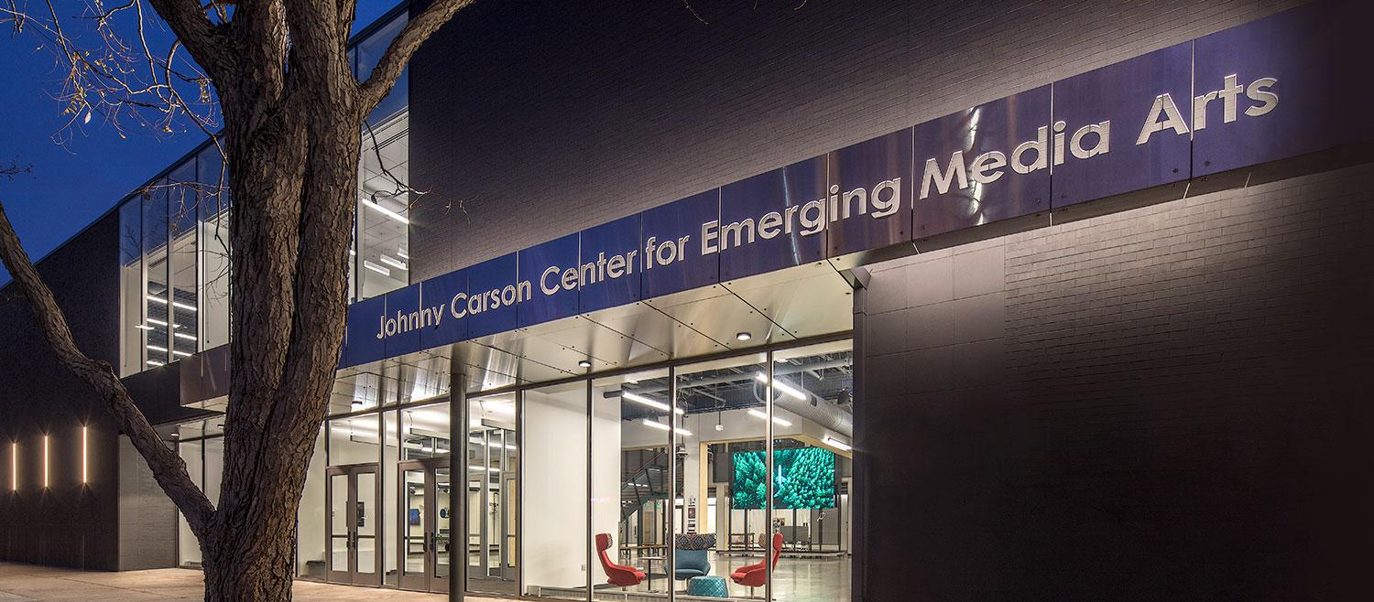

Slide 10
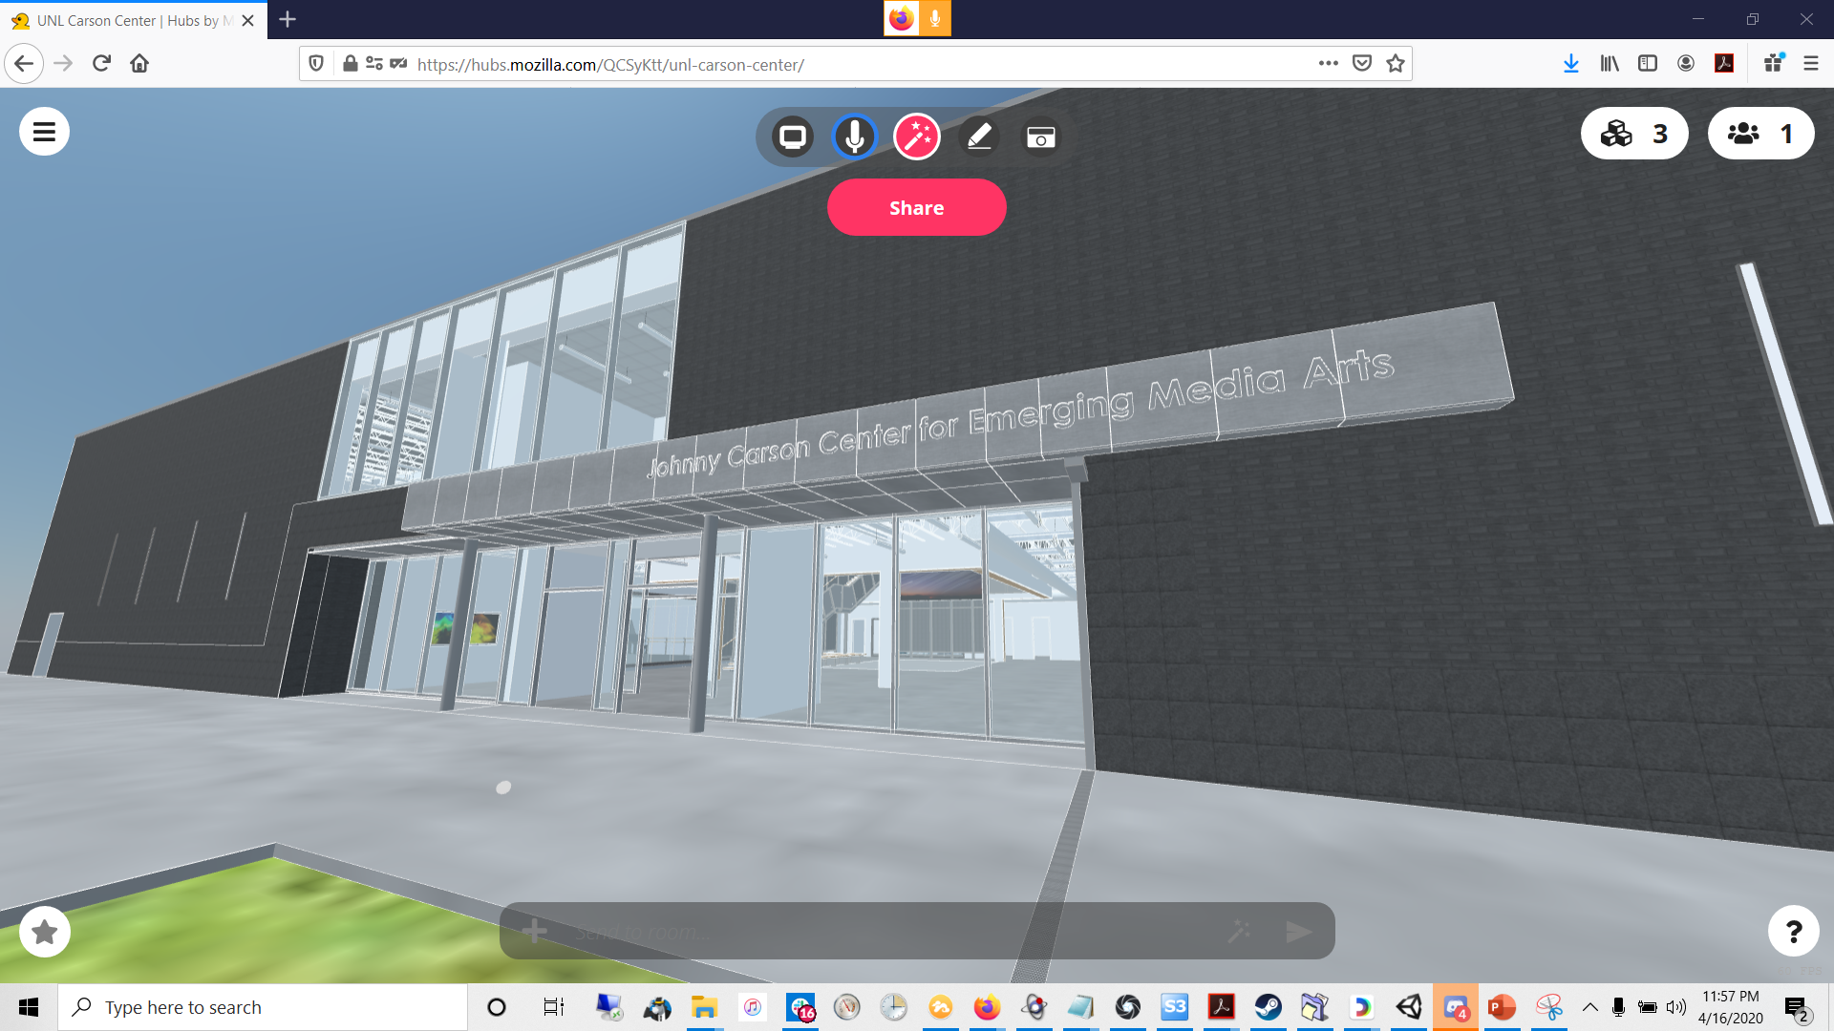

Slide 11
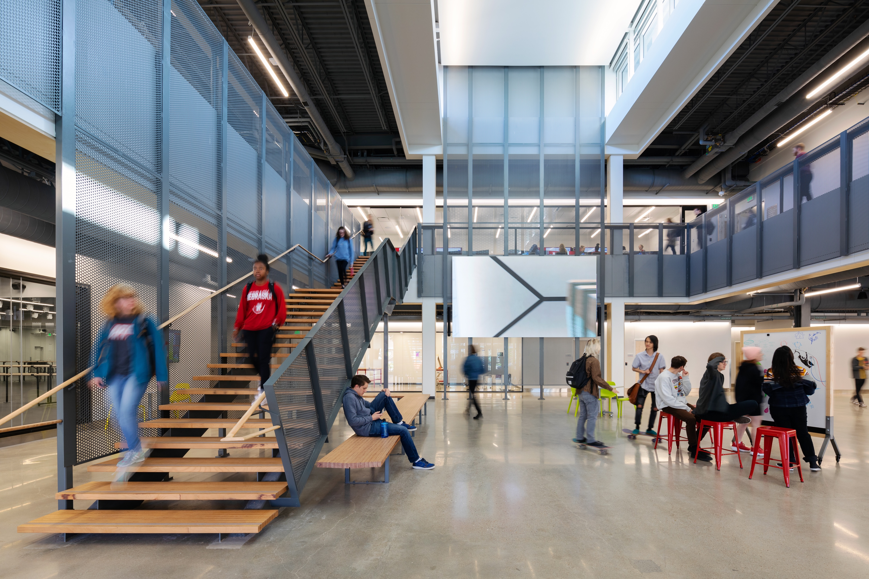
Notes:
The entire building is built on the principles of transparency, flexibility, openness. Everywhere is a learning space, and everything is on wheels so that it can be changed in a heart beat. When we were designing the building the architects, faculty and I went to Pixar, YouTube Spaces, We Work, Google, California College of the Arts, the Art Center in Pasadena, Hudl – to get ideas about how to future proof our building and about the future of work.

Slide 12
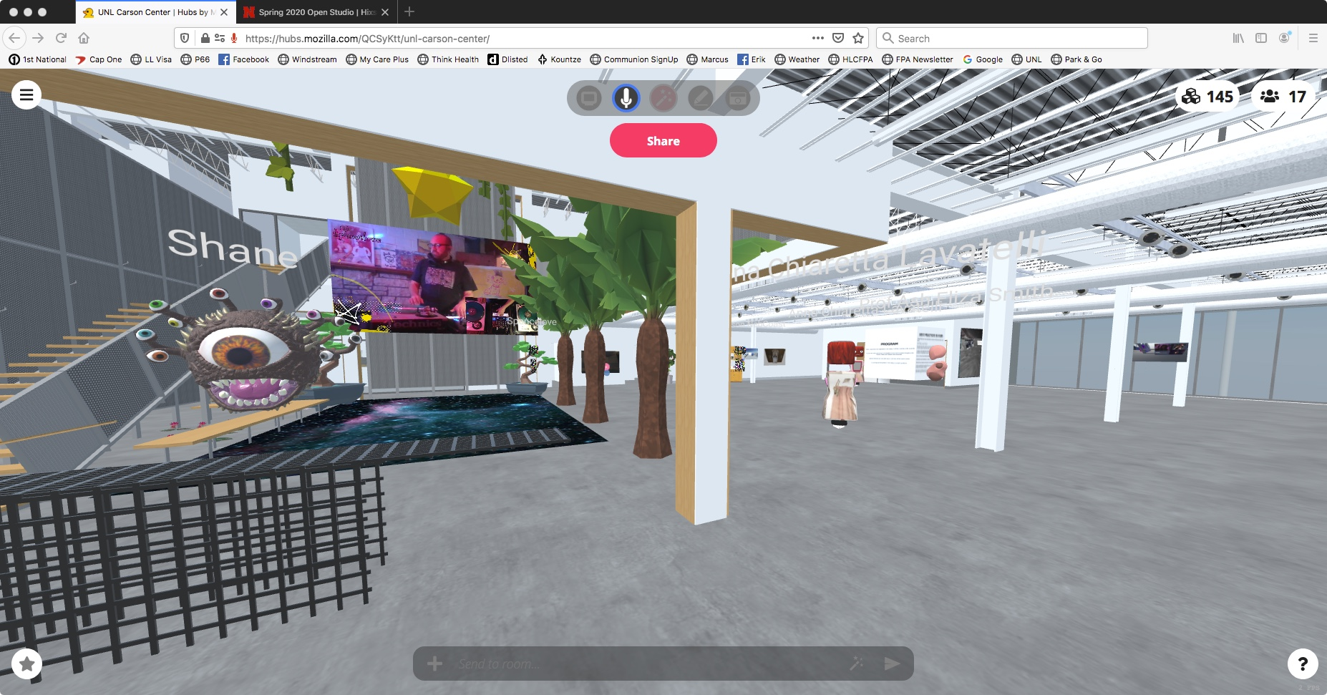

Slide 13
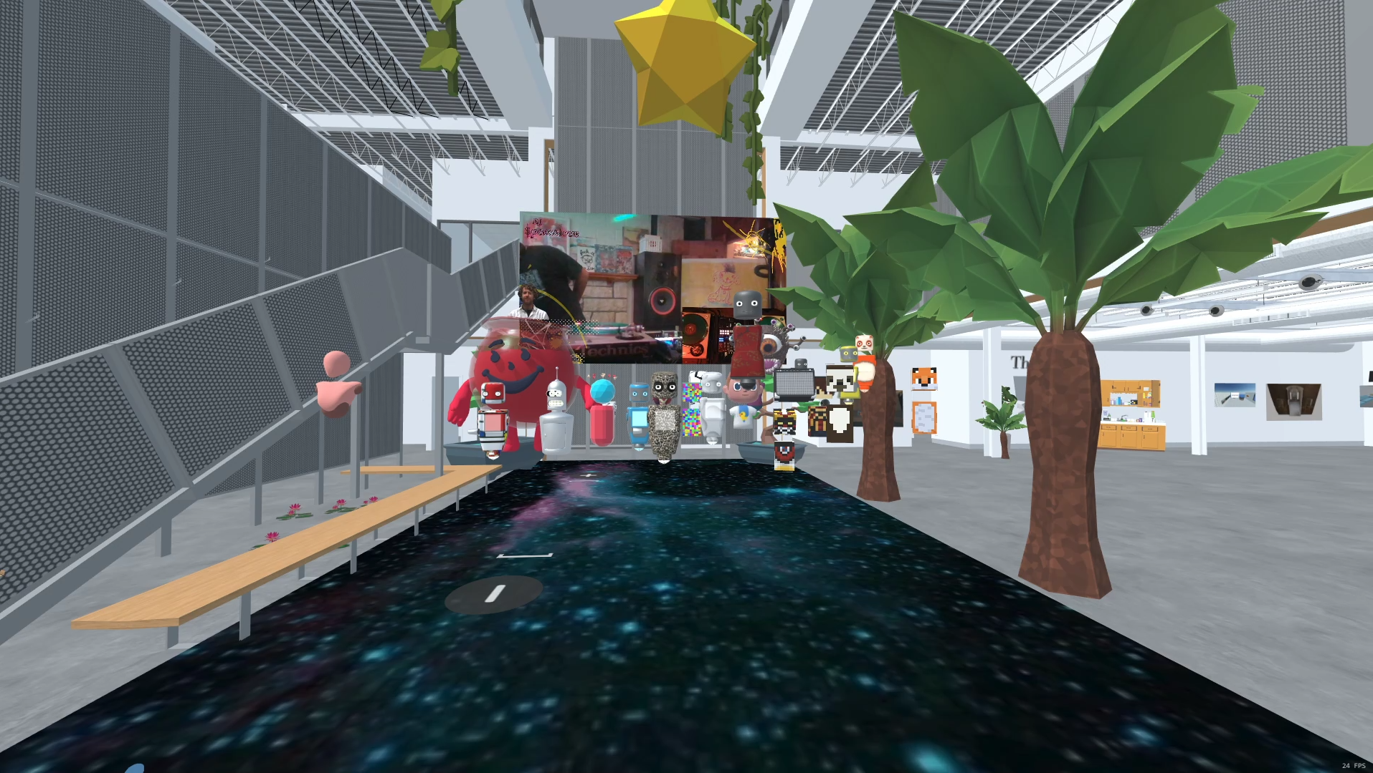

Slide 14


Slide 15
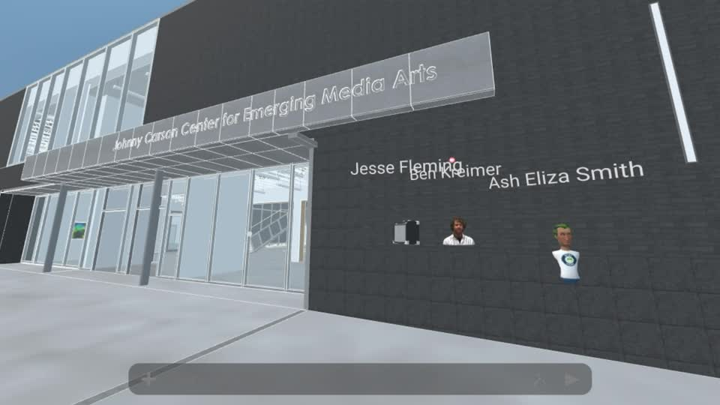

Slide 16
CARSONCENTER.UNL.EDU
FALL 2020
Professor Ash Eliza Smith
STORY LAB I
Notes:
On the one had there’s Emerging Media = Technology
On the other hand, there’s Media Arts = Creativity

Slide 17
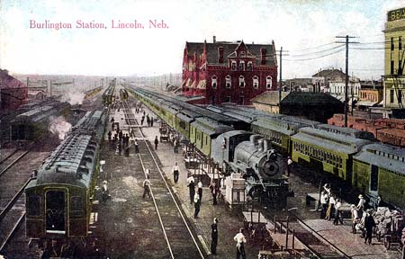
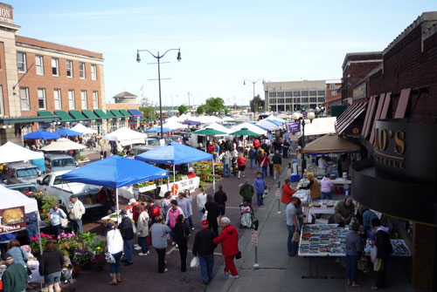
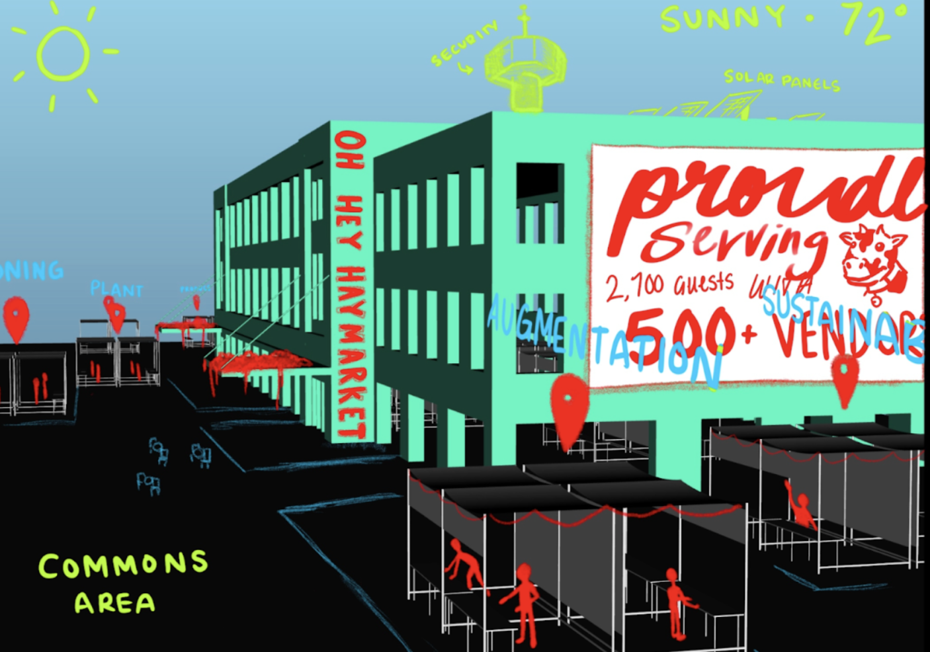
OH HEY HAYMARKET!
CARSONCENTER.UNL.EDU
Notes:
On the one had there’s Emerging Media = Technology
On the other hand, there’s Media Arts = Creativity

Slide 18
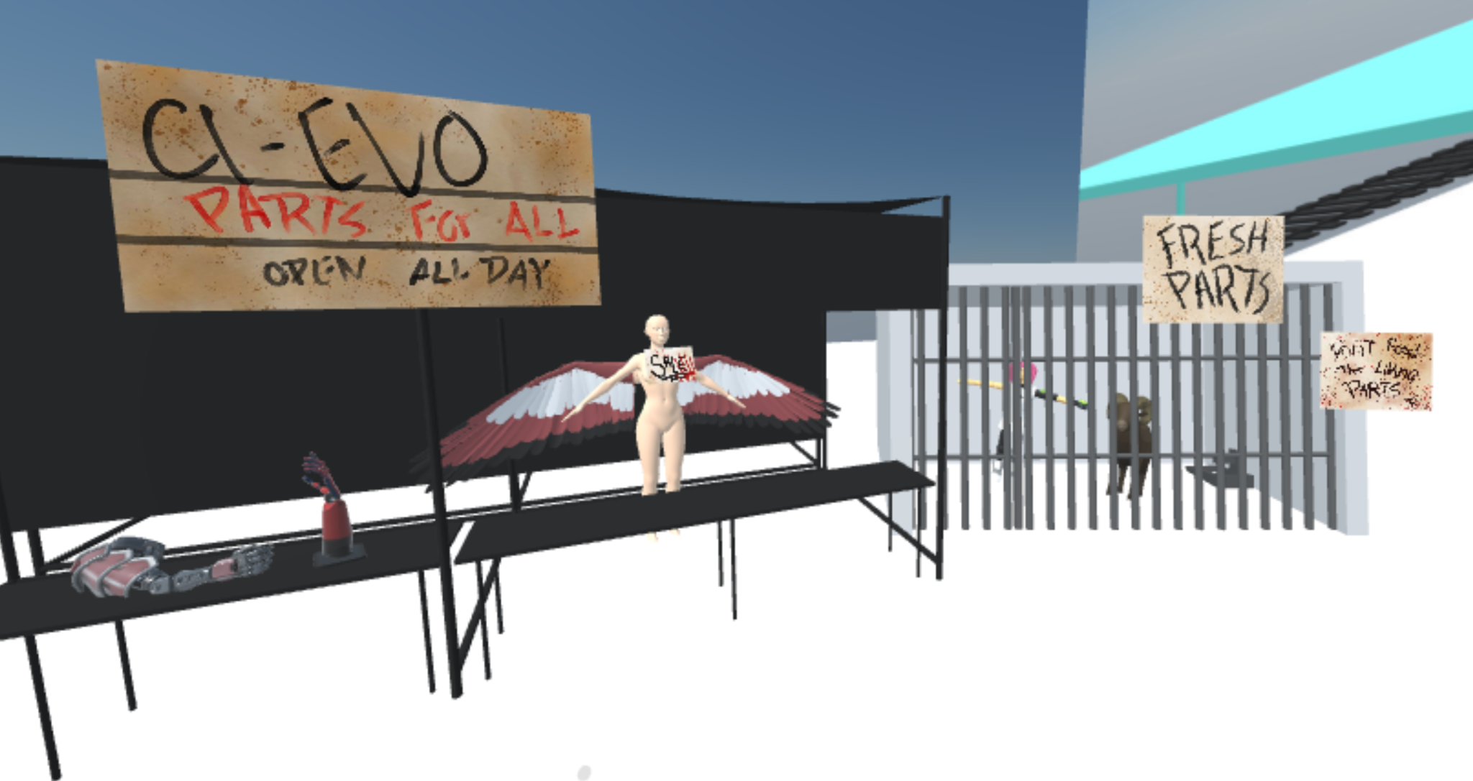
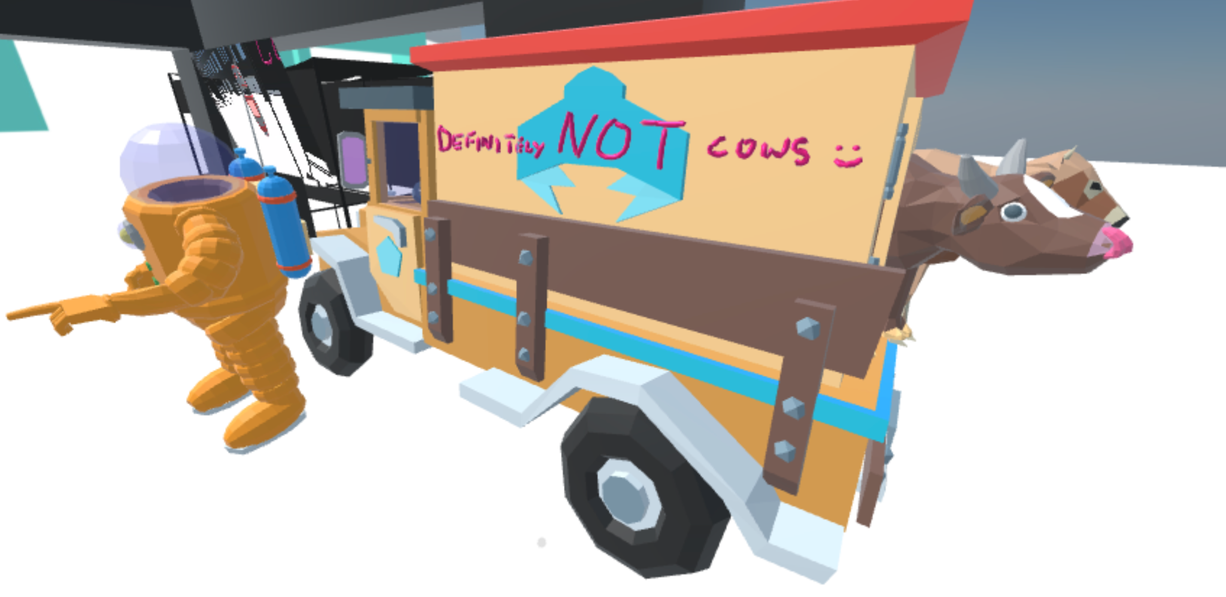
MOZILLA HUBS AS A CONTAINER FOR STORY
CARSONCENTER.UNL.EDU
Notes:
On the one had there’s Emerging Media = Technology
On the other hand, there’s Media Arts = Creativity

Slide 19
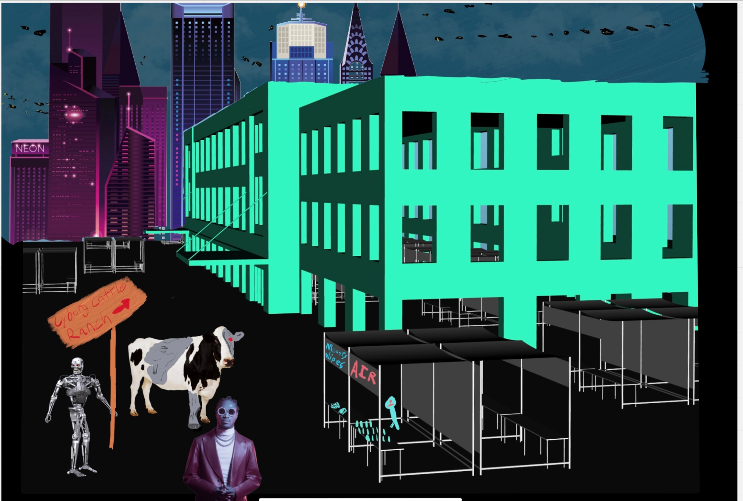
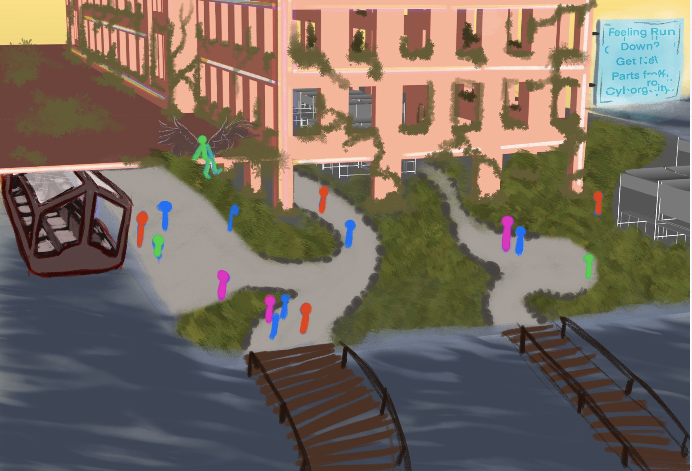
NARRATIVE + PRE-VISUALISATION
CARSONCENTER.UNL.EDU
Notes:
On the one had there’s Emerging Media = Technology
On the other hand, there’s Media Arts = Creativity

Slide 20
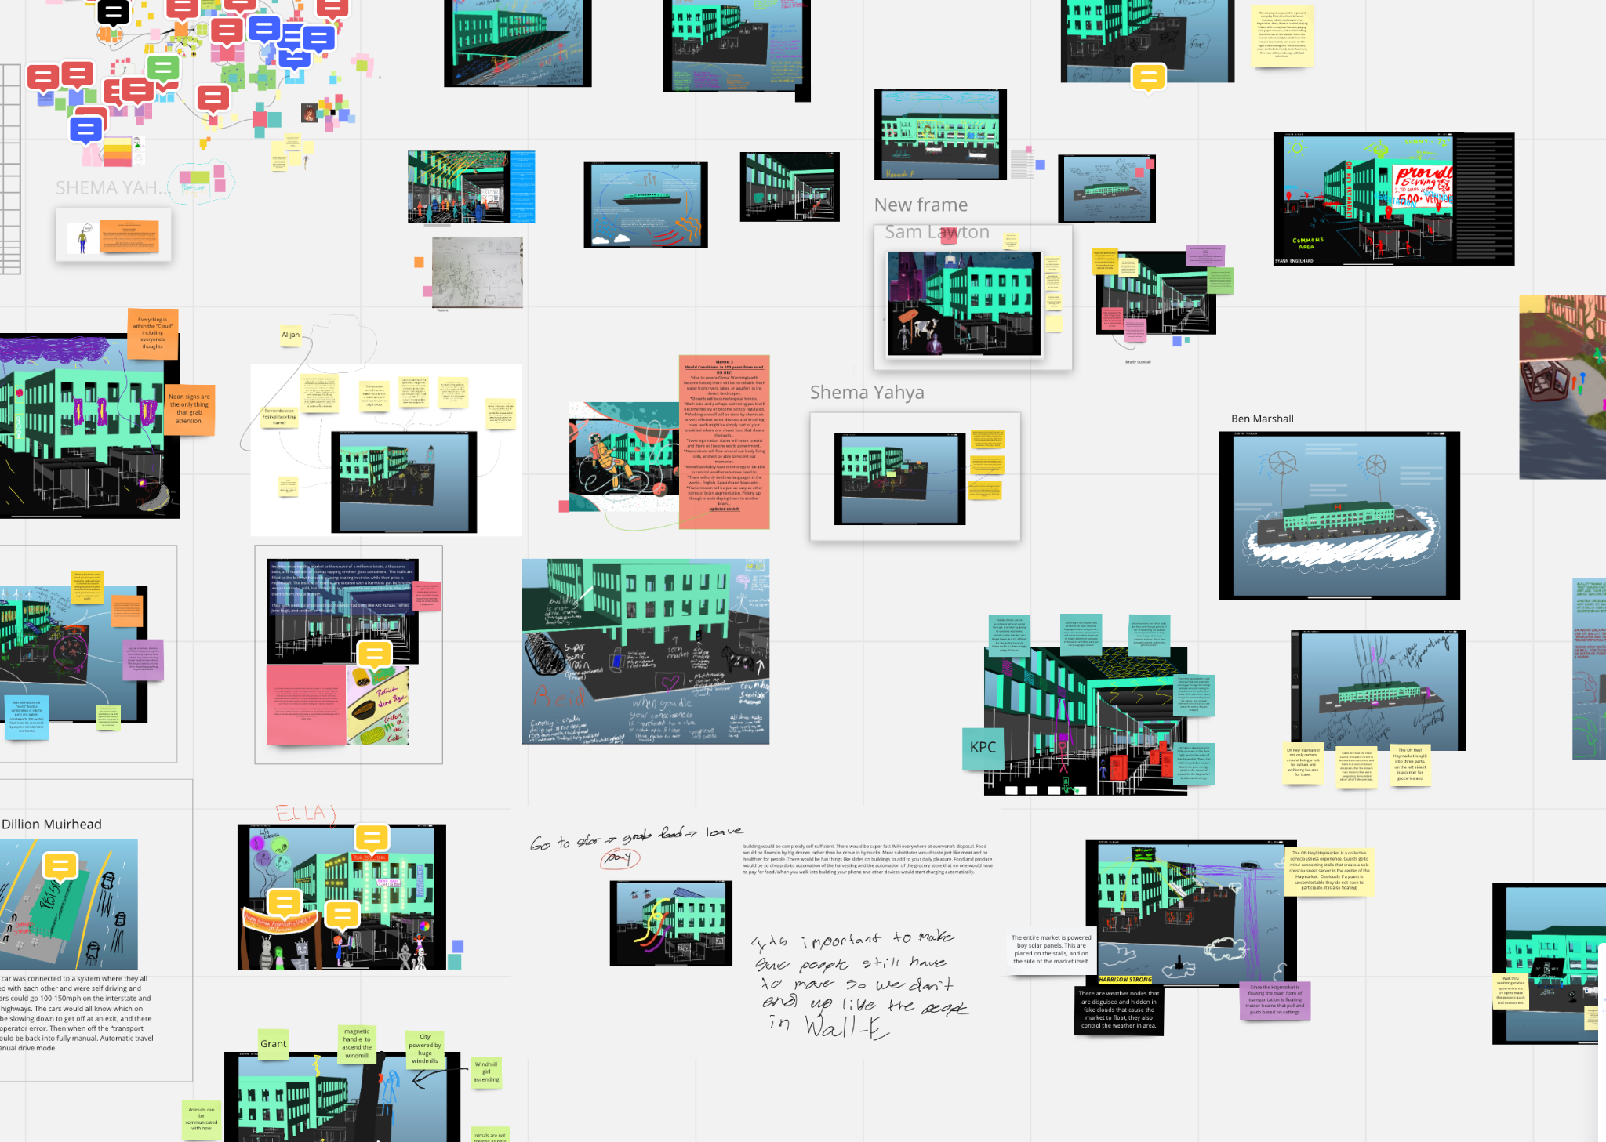
NARRATIVE + PRE-VISUALISATION – USING MIRO
CARSONCENTER.UNL.EDU
Notes:
On the one had there’s Emerging Media = Technology
On the other hand, there’s Media Arts = Creativity

Slide 21
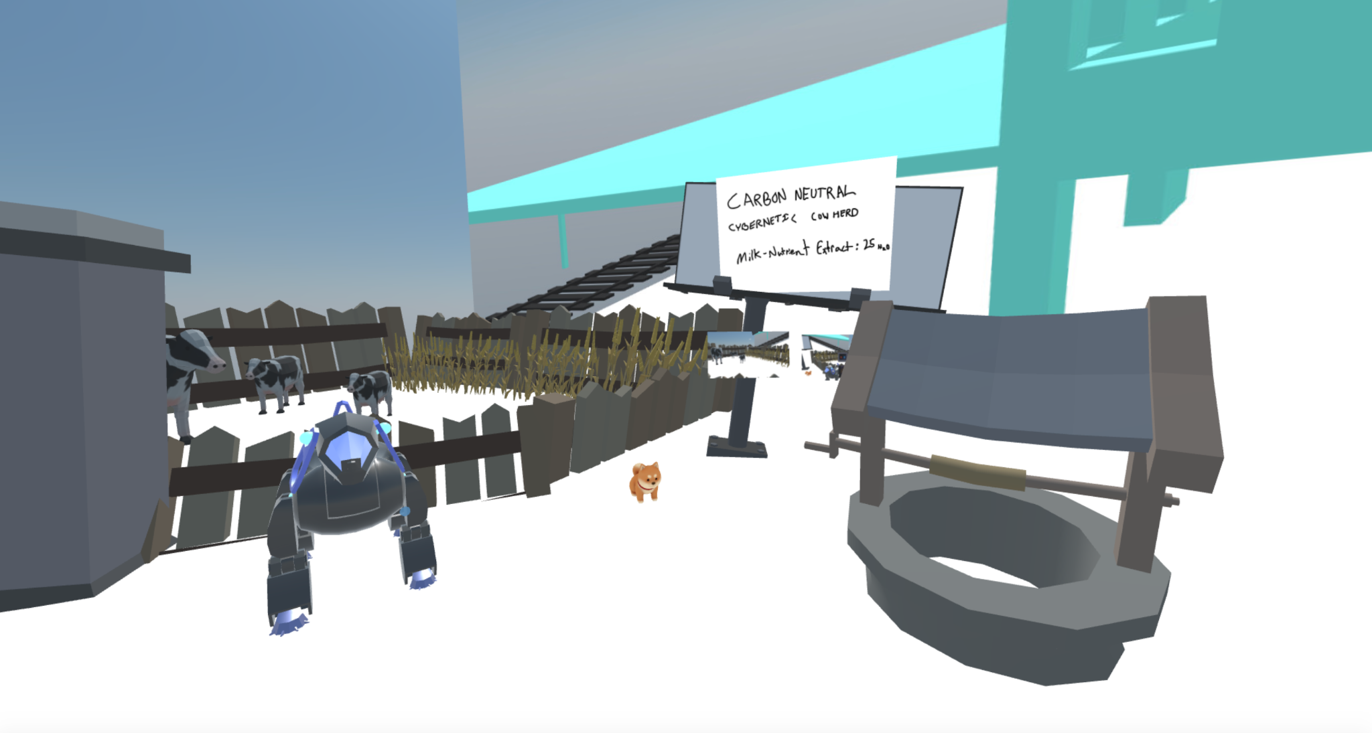
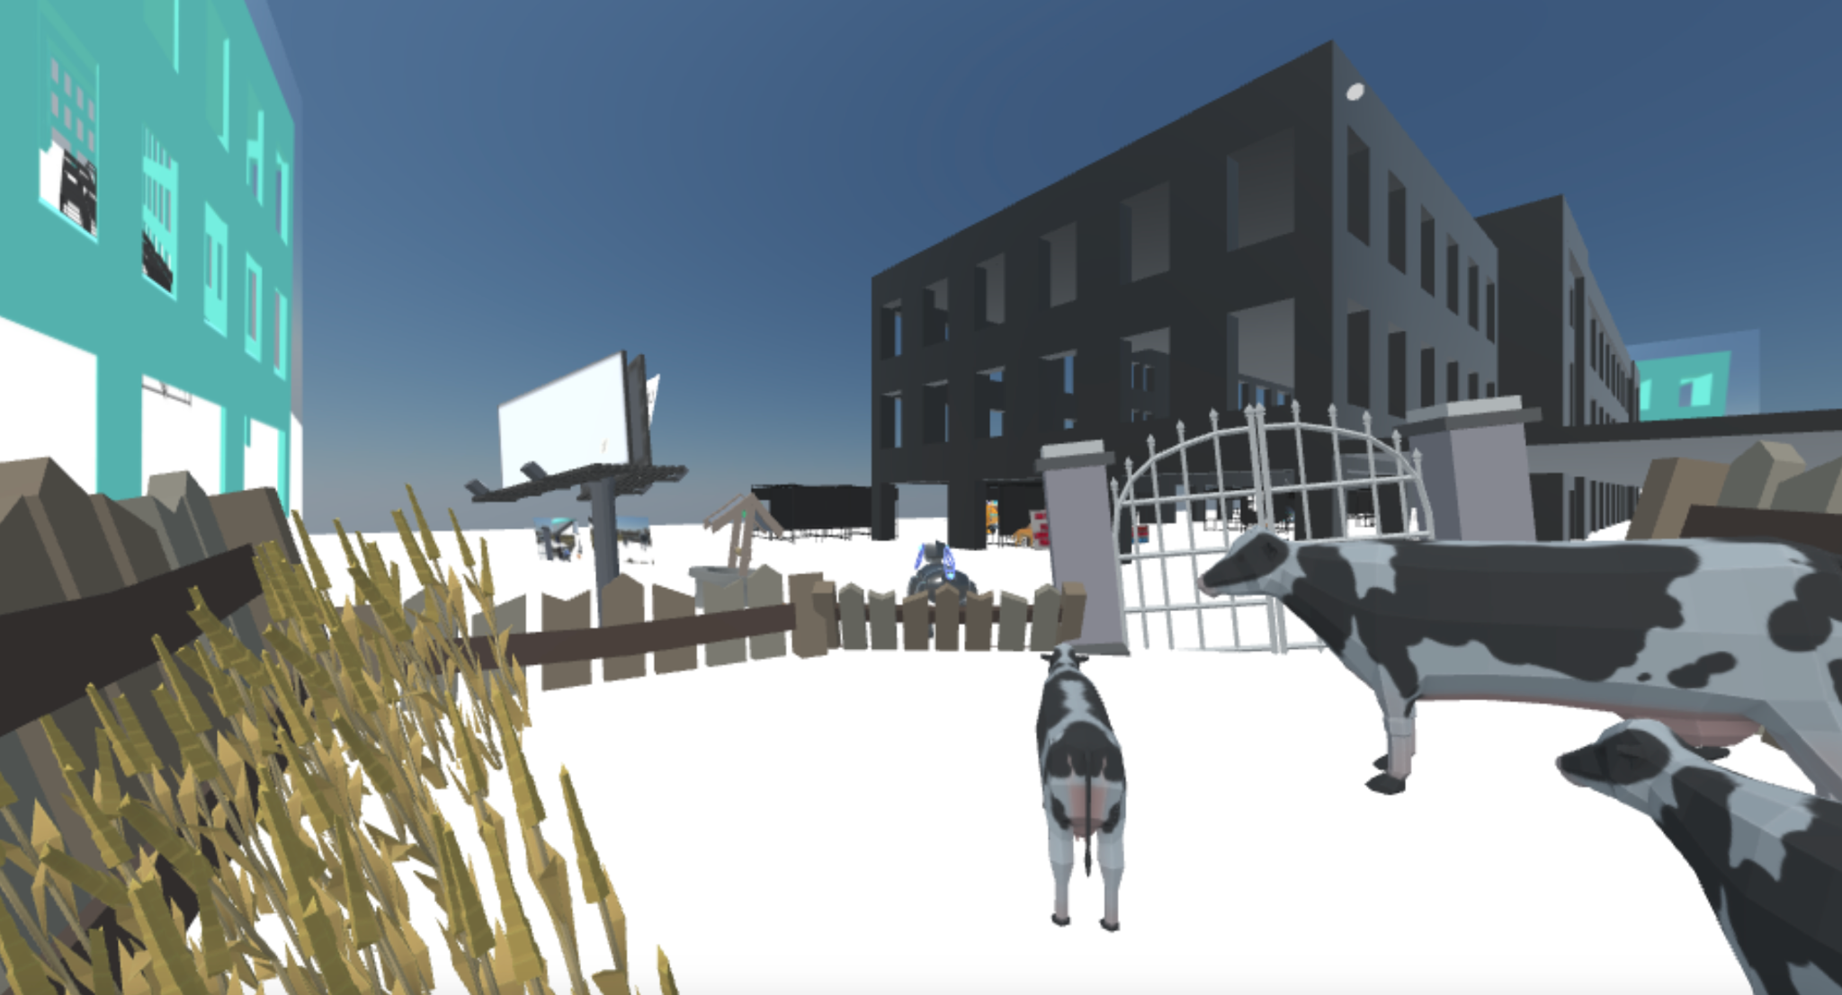
CREATIVE PROBLEM SOLVING – above + below
CARSONCENTER.UNL.EDU
Notes:
On the one had there’s Emerging Media = Technology
On the other hand, there’s Media Arts = Creativity

Slide 22
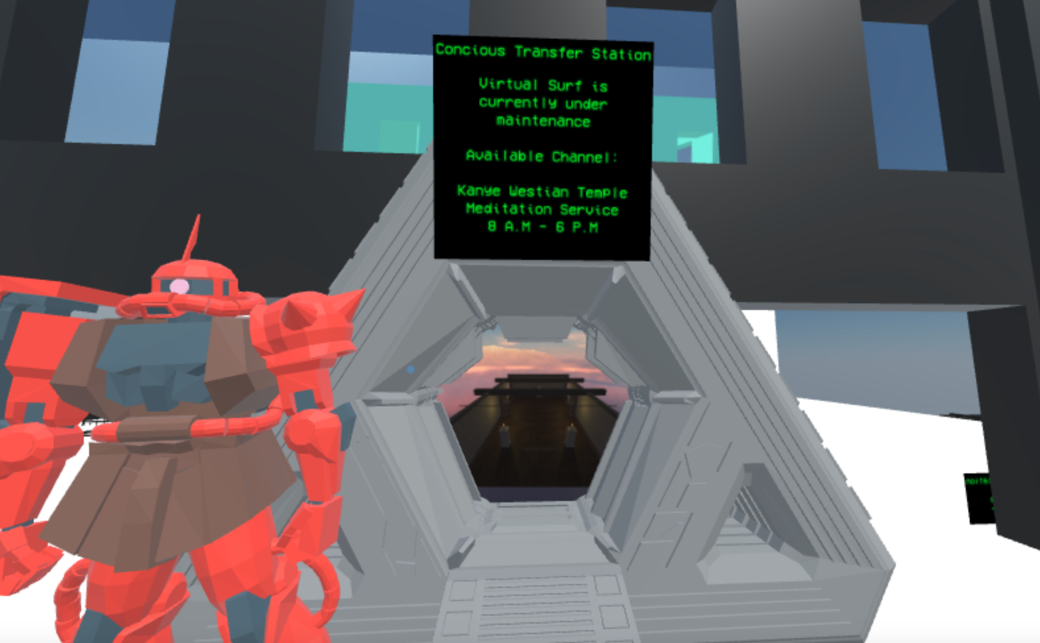
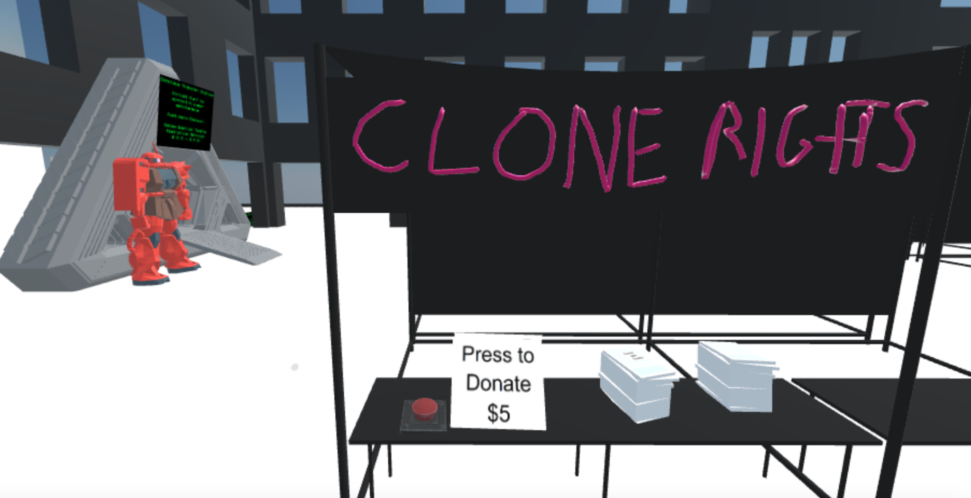
SET THE SCENE – Prompts + Design Fictions
CARSONCENTER.UNL.EDU
Notes:
On the one had there’s Emerging Media = Technology
On the other hand, there’s Media Arts = Creativity

Slide 23
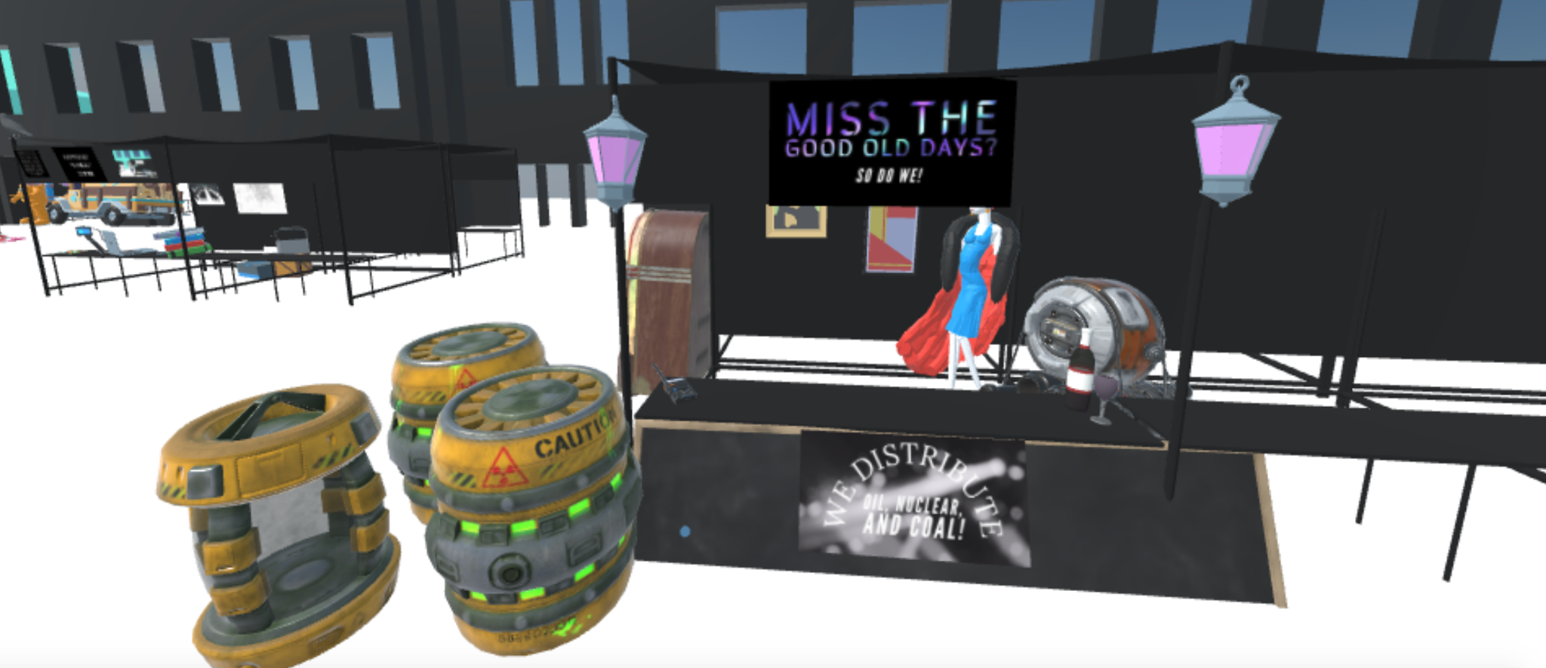
SET THE SCENE – Prompts + Design Fictions
CARSONCENTER.UNL.EDU
Notes:
On the one had there’s Emerging Media = Technology
On the other hand, there’s Media Arts = Creativity

Slide 24

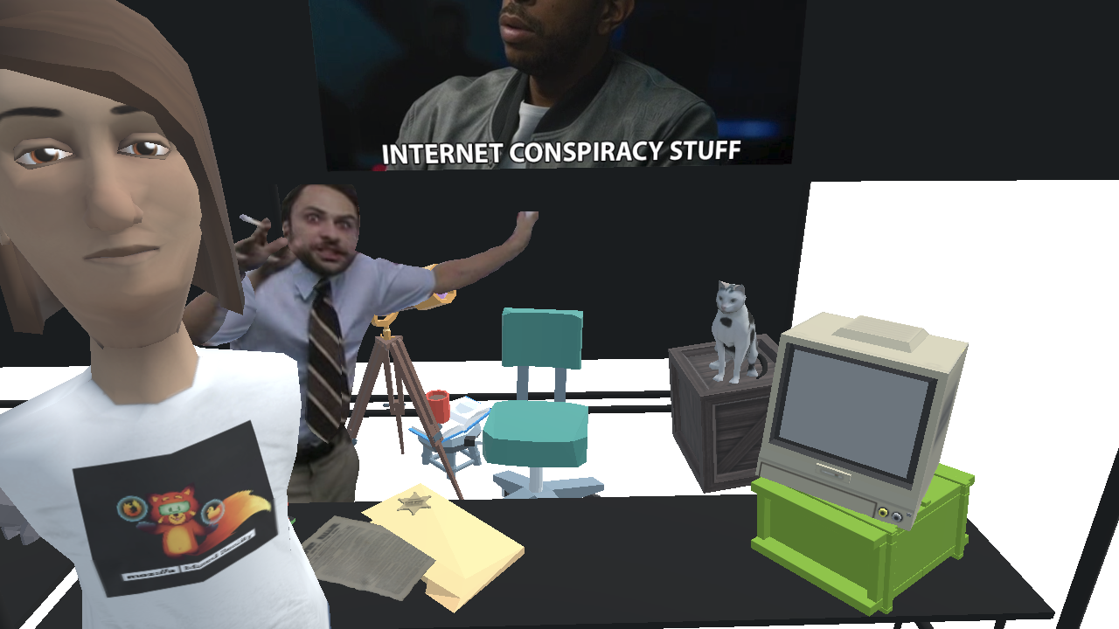
LIVE ACTION ROLE PLAYING
CARSONCENTER.UNL.EDU
Minkä Puloesta Taistelimme: Muisto (Larp)
photo by Mira Strengell
Notes:
On the one had there’s Emerging Media = Technology
On the other hand, there’s Media Arts = Creativity

Slide 25
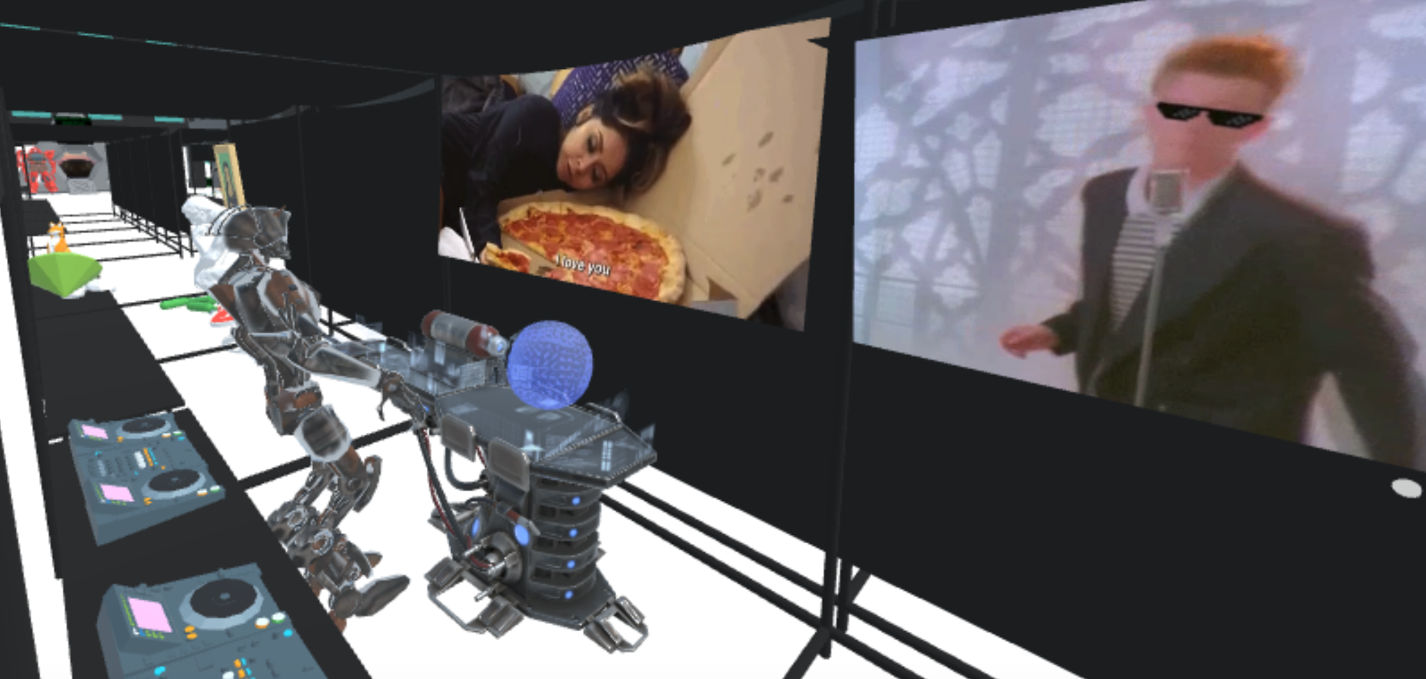
CONTINUATION INTO CINEMA SPACE
CARSONCENTER.UNL.EDU
Notes:
On the one had there’s Emerging Media = Technology
On the other hand, there’s Media Arts = Creativity

Slide 26
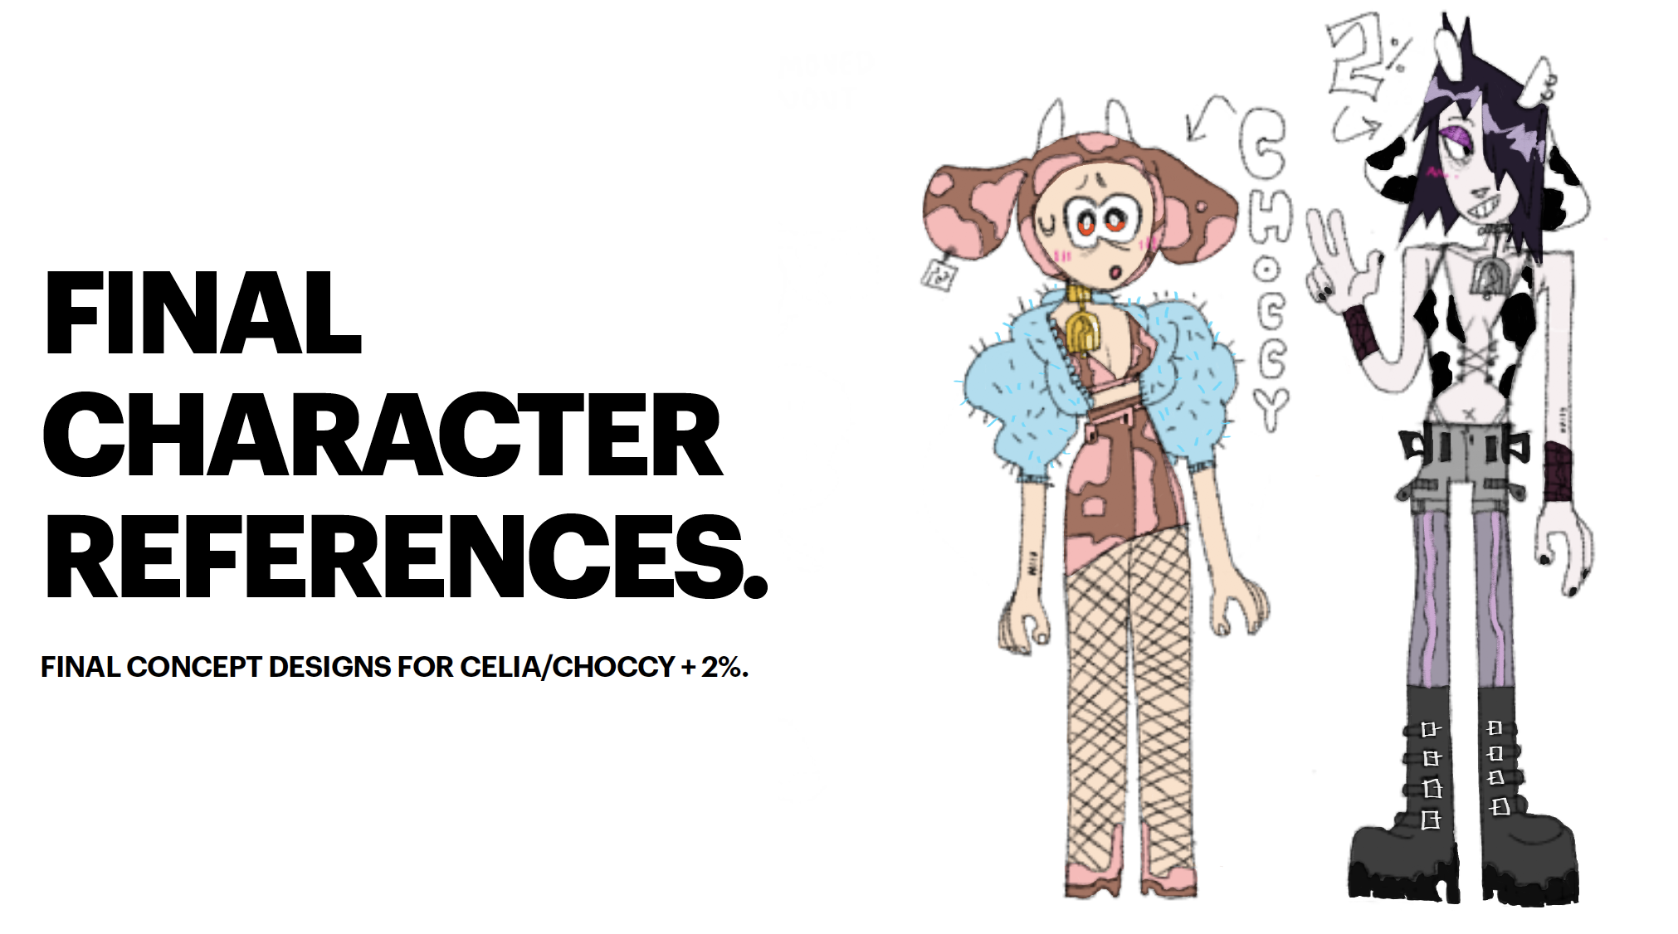
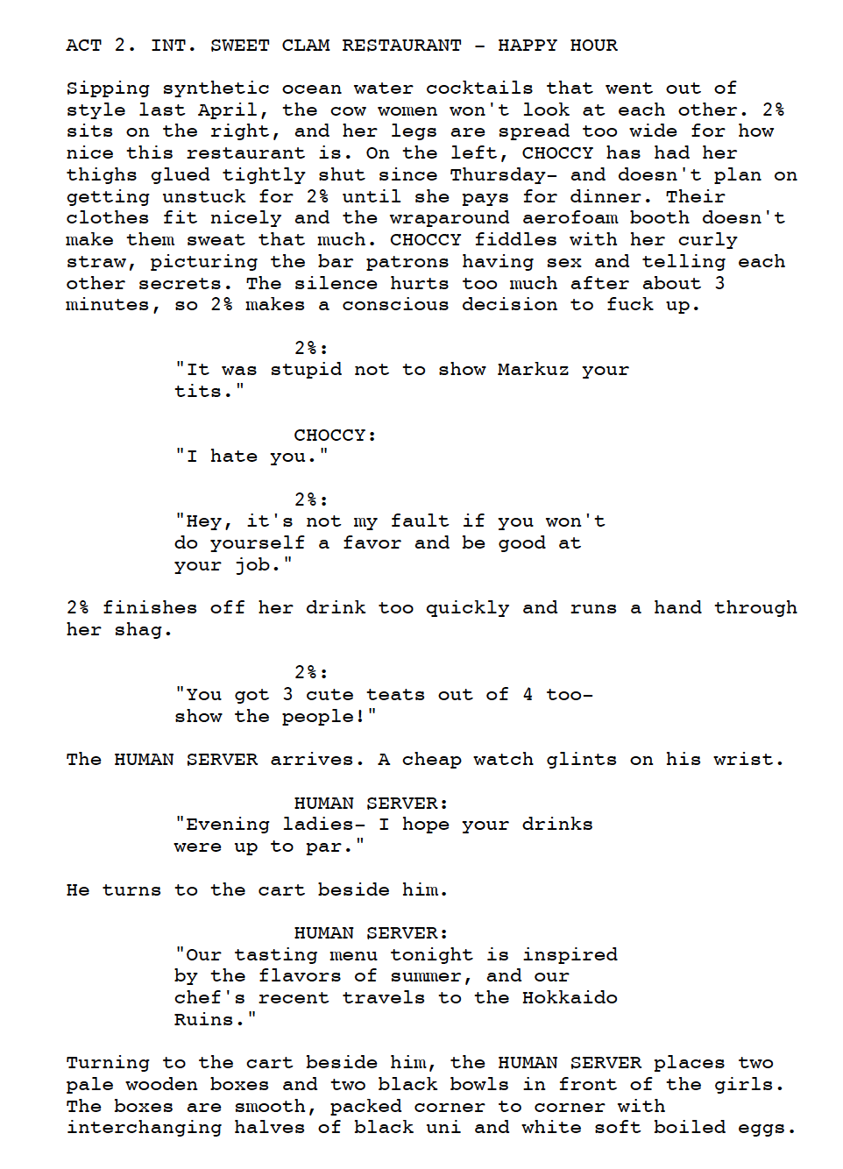
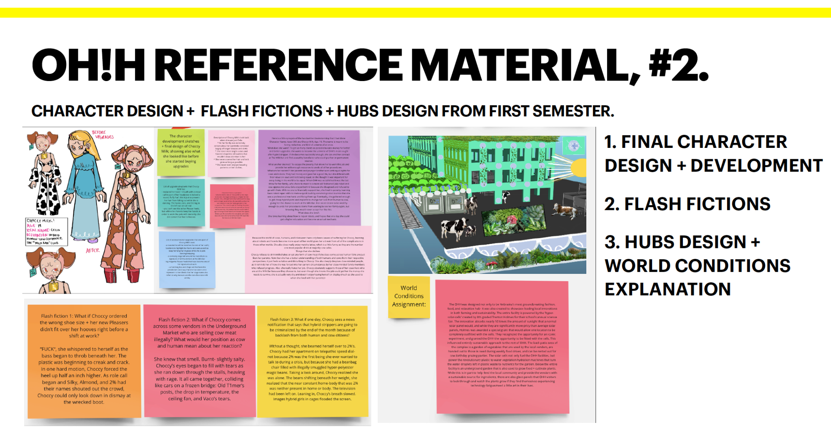
Prof. Ash Eliza Smith, STORY LAB I, Fall 2020

Slide 27
CARSONCENTER.UNL.EDU
SPRING 2021
Professor Anna Henson
CREATING AUGMENTED WORLDS
Notes:
On the one had there’s Emerging Media = Technology
On the other hand, there’s Media Arts = Creativity

Slide 28
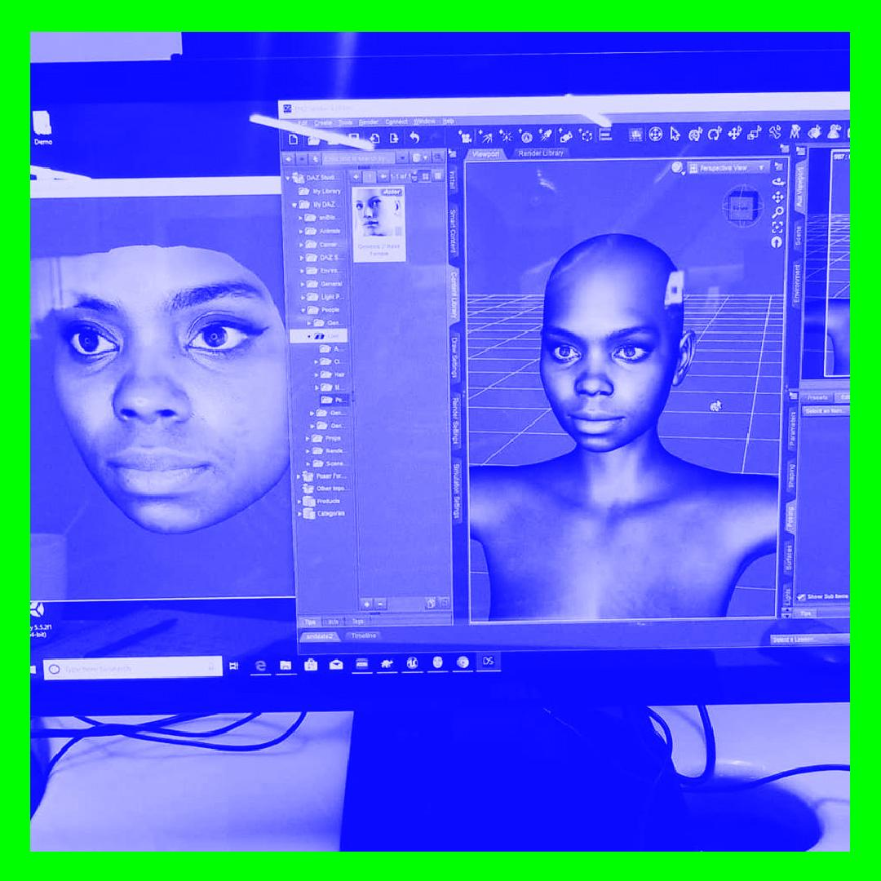

WORKSHOP WITH LAJUNE MCMILLIAN
CARSONCENTER.UNL.EDU
Notes:
On the one had there’s Emerging Media = Technology
On the other hand, there’s Media Arts = Creativity

Slide 29
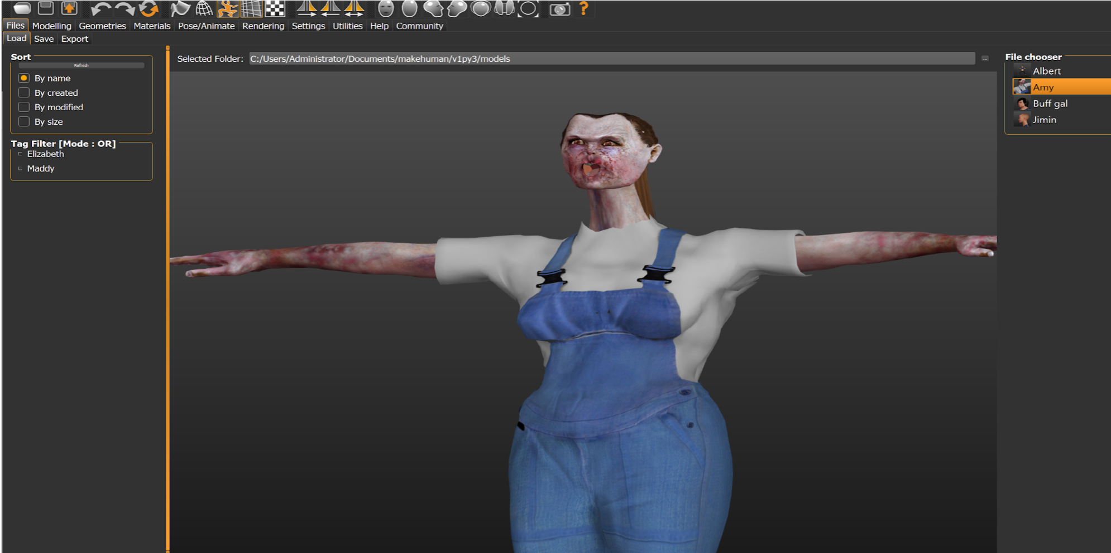
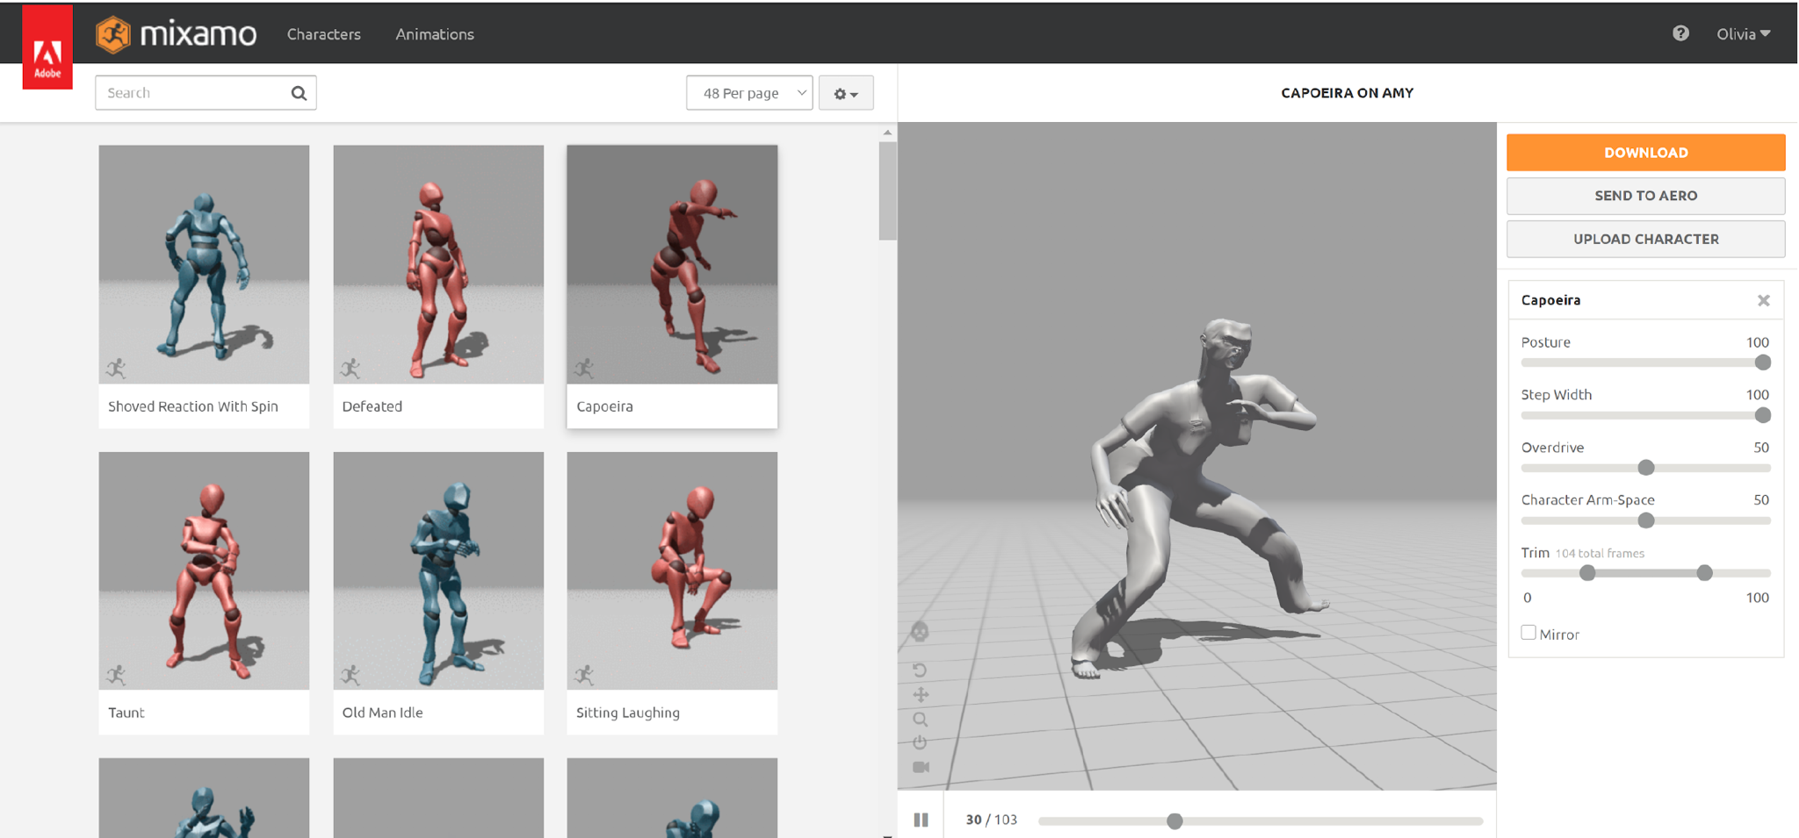
AVATAR CREATION WITH MAKEHUMAN, BLENDER, MIXIMO
CARSONCENTER.UNL.EDU
Notes:
On the one had there’s Emerging Media = Technology
On the other hand, there’s Media Arts = Creativity

Slide 30
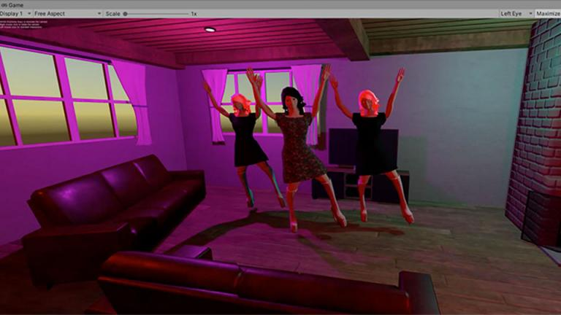
THERE IS ALWAYS DANCING IN VR
CARSONCENTER.UNL.EDU
Notes:
On the one had there’s Emerging Media = Technology
On the other hand, there’s Media Arts = Creativity

Slide 31
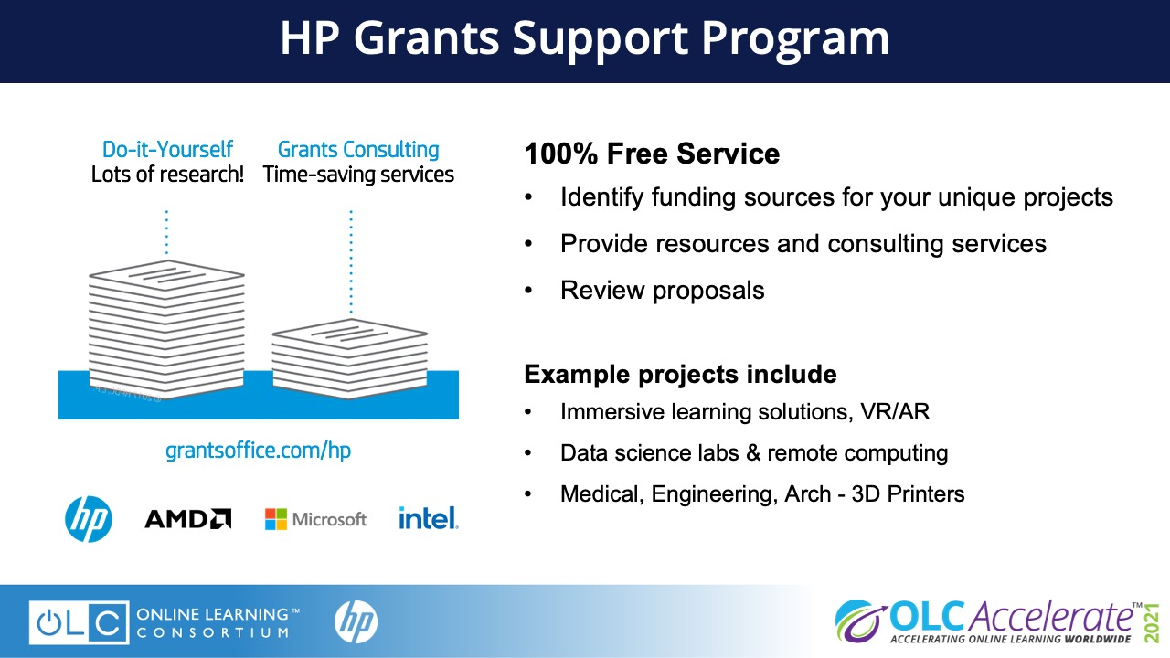

Slide 32
